Slide 1
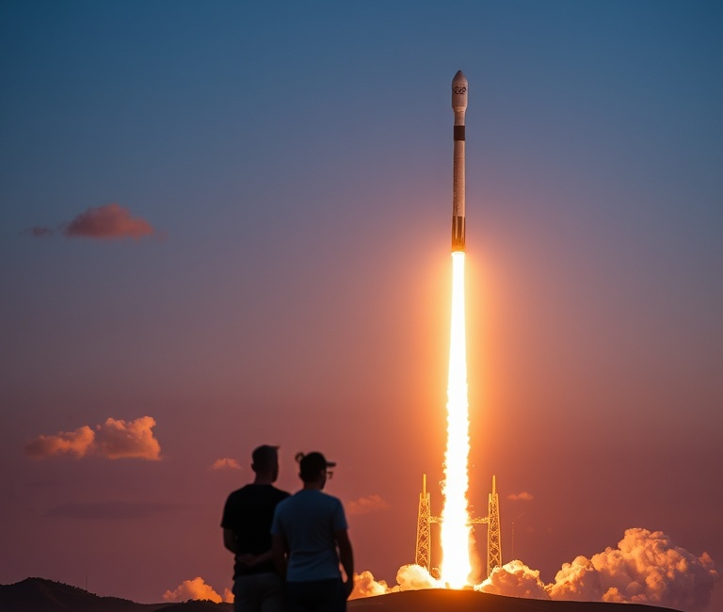

SPACEX IBM Data Science Project
Sion Pritchard
04/ 09/ 2025

Slide 2
Outline
Executive Summary
Introduction
Methodology
Results
Conclusion
Appendix

Slide 3

Executive Summary
Objective: Analyse SpaceX Falcon9 launch data to determine factors influencing landings and predicted mission outcomes.
Approach: Collected and wrangled data from multiple sources Conducted EDA with visualisation, SQL queries, and interactive dashboards Built and evaluated predictive models using machine learning (KNN, decision tree, logistic regression, SVM)
Key insights: Launch site, payload mass, and orbit type significantly impact landing success NASA (CRS) missions carried the highest cumulative payloads Certain landing outcomes strongly correlate with booster reuse
Impact: Provides data-driven evidence for SpaceX’s cost-reduction strategies Predictive model achieved strong accuracy, aiding in forecasting mission success

Slide 4

Introduction
This project delves into the intricacies of SpaceX’s rocket launching reusability
Problem: Rocket launchers are costly, SpaceX can save a lot of money by reusing rocket launchers, they can save a lot more money by accurately predicting when a rocket landing will be a success, thus knowing whether they can reuse parts of the rocket
Goal: By using data science methods, we can predict the landing success of rockets allowing SpaceX to save money building new rocket launchers

Slide 5


methodology

Slide 6
Data Collection
Using a GET request, we requested and parsed the SpaceX launch data. The response content was decoded as a JSON and turned into a Pandas dataframe.
An API was used to get further information about specific columns (rocket, payloads, launchpad, and cores).
Clean the requested data: Data was cleaned, keeping only Falcon 9 launches, the dataframe was filtered using BoosterVersion.
Data collection Lab: Course10/jupyter-labs-spacex-data-collection-api.ipynb at main · Sion719/Course10

Slide 7

Web scraping
To webscrape SpaceX’s Wikipedia page, a HTTP GET method was performed to request the Falcon9 launch HTML page, then a BeautifulSoup object was created by the HTML response.
BeautifulSoup was then used to find all tables within the Wikipedia page.
By parsing the launch HTML tables, a dataframe was created.
Web Scraping Lab: Course10/jupyter-labs-webscraping.ipynb at main · Sion719/Course10

Slide 8
Data wrangling
Firstly, the number of launches on each site was calculated, then the number and occurrence of each orbit was counted so that we could determine the number of landing outcomes. This means we can now assign a binary variable to distinguish the outcome of the rocket landings.
Data Wrangling Lab: Course10/labs-jupyter-spacex-Data wrangling.ipynb at main · Sion719/Course10

Slide 9
EDA with SQL
SQL code was written to display the total payload mass carried by the boosters launched by NASA (CRS) and the booster version F9 v1.1. SQL was then used to list the total number of successful and unsuccessful mission outcomes.
EDA with SQL Lab: Course10/jupyter-labs-eda-sql-coursera_sqllite.ipynb at main · Sion719/Course10

Slide 10
EDA with data visualisation
Using scatterplots, the relationship between flight number and launch site was visualised, and so was the relationship between payload mass and launch site.
A bar chart was used to see if there is a relationship between the success rate and orbit type.
More scatterplots were used to visualise the relationship between flight number and orbit type, and between payload mass and orbit type.
A line chart was used to observe how the success rate developed year on year.
For consistency purposes all numeric columns were developed to float64 format.
EDA with Visualisation Lab: Course10/edadataviz.ipynb at main · Sion719/Course10

Slide 11

Build an interactive map with Folium
Folium was used to create an interactive map. The NASA Johnson Space Center in Houston, Texas was made as the center point, using Folium.circle to add a highlighted circle around the space center’s location.
A dataframe was created to classify successful and unsuccessful launches by colour (green, red). They were also added to the map, Folium clusters were created to show the location of the launches and identify the success rates of launch sites.
A mouse position was created to get location coordinates. A polyline was drawn from landing sites and the coastline to measure distance, this helps to easily answer questions such as “Are launch sites in close proximity to the coastline?”.
Folium Lab: Course10/lab_jupyter_launch_site_location.ipynb at main · Sion719/Course10

Slide 12

Build a dashboard with Plotly

Slide 13
Predictive Analysis (Classification)
Built a machine learning model to predict if the first stage will land so that we can determine the cost of a launch.
A NumPy array was created for the Class column, the data was then standardised and reassigned using a transform. The data was split into training and test sets.
A logistic regression object was created and a GridSearchCV object was created with a CV of 10. Using the score method, we calculated the accuracy of the test data and visualised it using a confusion matrix.
A support vector machine object and a GridSearchCV was created with a CV of 10. Using the score method, we calculated the accuracy of the test data and visualised it using a confusion matrix.

Slide 14
Predictive Analysis (Classification)
A decision tree classifier object and a GridSearchCV with a CV of 10 was created, the accuracy was calculated using the score method and a confusion matrix was used for interpretation.
A KNN object was created using a GridSearch CV with a CV of 10, the accuracy was calculated using the score method and interpreted using a Confusion matrix.
Each method was then evaluated in detail to discover which method was most effective.
ML Prediction Lab: Course10/SpaceX_Machine Learning Prediction_Part_5.ipynb at main · Sion719/Course10

Slide 15

Results

Slide 16
Insights drawn from EDA

Slide 17
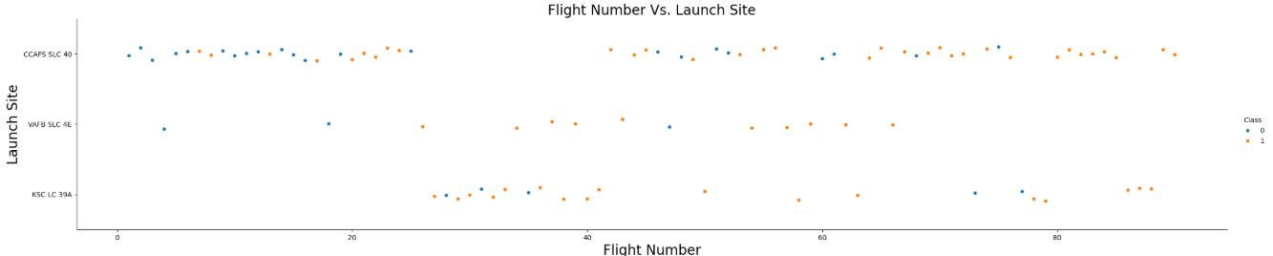
Flight Number vs Launch Site
Trend over time: Flight outcomes improve with higher flight numbers, highlighting modellable temporal learning effects.
01
Site distribution: Launch activity is concentrated at CCAFS SLC 40, with KSC LC 39A, and VAFB SLC 4E as secondary sites.
02
Predictive insight: Success rates (Class = 1) rise over time, suggesting launch site and flight sequence are strong candidate features for classification models.
03

Slide 18
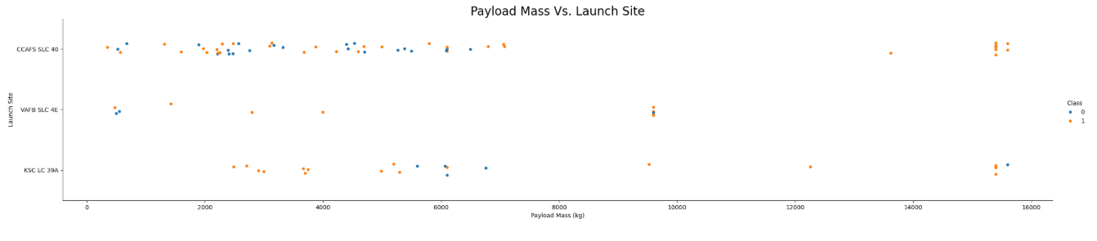
Payload vs Launch Site
Payload variation: Heavier payloads (up to 16,000kg) are observed at both CCAFS SLC 40 and KSC LC 39A, while VAFB SLC 4E is limited to lighter payloads (<10,000kg).
Success relationship: Across sites, higher payloads show mixed outcomes, but success is consistently present even at maximum payloads, this indicates system robustness.
Feature insight: Payload mass is a key variable but not the sole predictor of success.

Slide 19
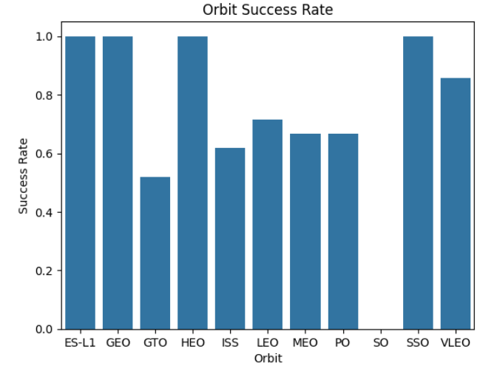
Success rate vs Orbit Type

Slide 20
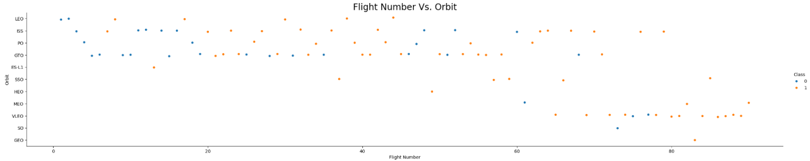
Flight Number vs Orbit Type
Early flights show more failures (blue dots) then later flights, this reflects the trial-and-error phase.
High success rates in later missions suggest technological maturity and improved reliability.
Success rate improves over time among all orbit types.

Slide 21
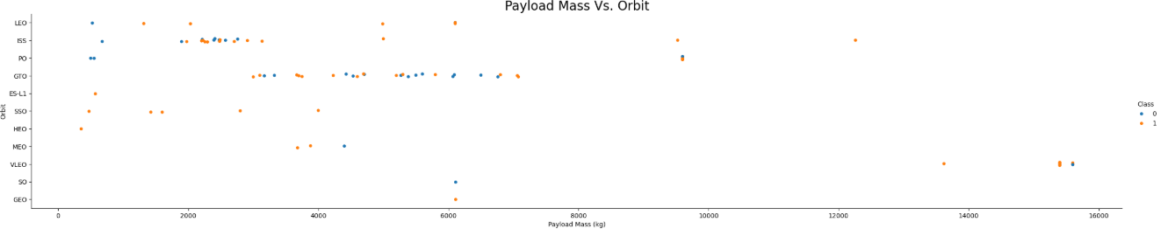
Payload vs Orbit Type
Only a few orbit types have payloads exceeding 10,000kg (ISS, PO, VLEO).
No correlation between orbit type and payload mass

Slide 22
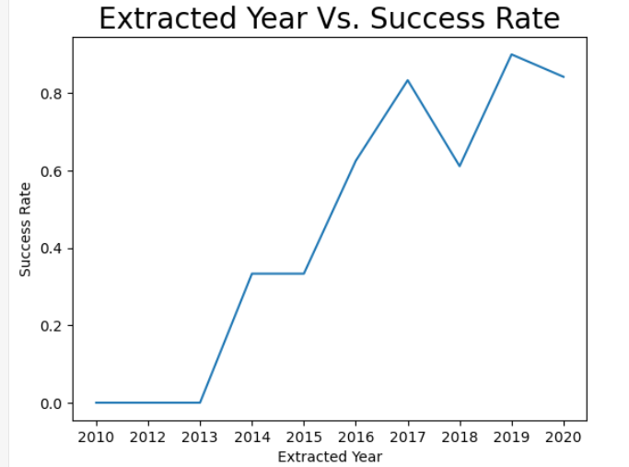
Launch Success Yearly Trend
Success rates were 0% up until 2013 where they began steadily increasing.
The success rate continuously increased from 2013 going from 0% and peaking at around 90% in 2019.
The year on year progression highlights how data-driven testing and development significantly improved mission reliability.

Slide 23
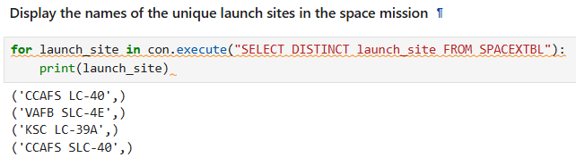
All Launch Site Names
The DISTINCT keyword ensures that only unique launch site names are returned.
This query helps us identify all the different launch locations used in the SpaceX missions dataset.
CCAFS SLC-40 → Cape Canveral Air Force Station Launch Complex 40
VAFB SLC-4E → Vandenberg Air Force Base Space Launch Complex 4E
KSC LC-39A → Kennedy Space Centre Launch Complex 39A

Slide 24
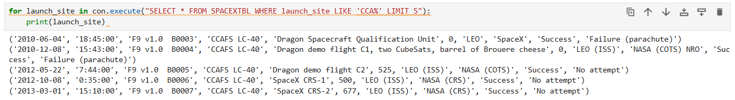
Launch site names beginning with ‘cca’
This query filters missions where the launch site starts with “CCA” (Cape Canveral) and shows the first five results.
The output lists early Falcon 9 launches from CCAFS LC-40 with details like payload mass, orbit, and mission outcome.
We can see that launches were not attempted or failed in these initial missions.

Slide 25
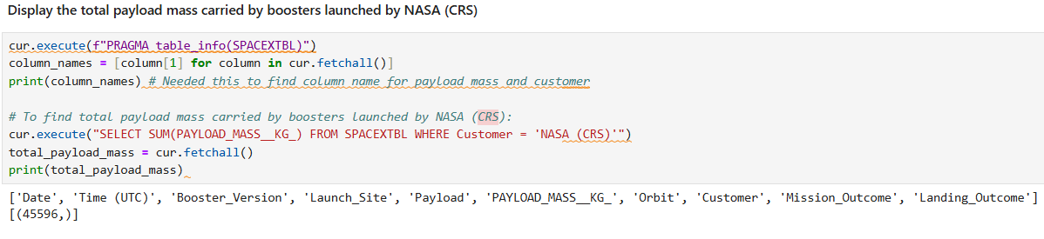
Total payload mass
This code calculates the total payload mass carried by SpaceX boosters for NASA (CRS) missions. It sends a SQL query to sum the payload_mass__kg_ column and filters only NASA (CRS) launches, it then retrieves the result and prints it. The database returned 45,596kg.

Slide 26
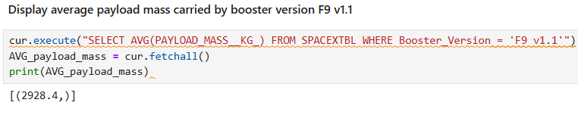
Average payload mass by f9 v1.1
This query calculates the average payload mass carried by the F9 v1.1 booster.
By looking only at launches with this booster version, the database computes the mean payload, which comes out to 2,928.4kg.
This represents the typical mass each F9 v1.1 carried into orbit.

Slide 27
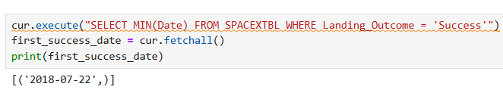
First successful ground landing date
This query finds the date of the very first successful SpaceX booster landing.
By checking only launches where the landing was successful, the database identifies July 22, 2018 as the milestone date for the company’s first landing achievement.

Slide 28
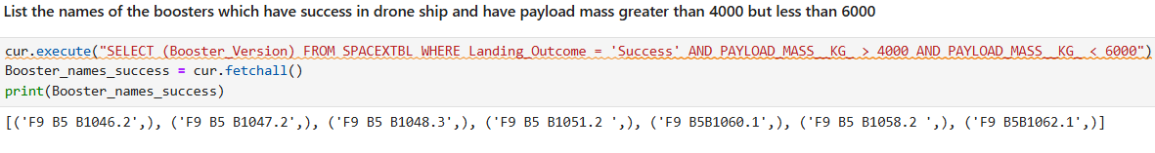
Successful drone ship landing with payload mass between 4000 and 6000
This query lists all booster versions that successfully landed while carrying a payload between 4,000kg and 6,000kg. The results show the specific boosters that achieved both a successful landing and a medium-weight payload.

Slide 29
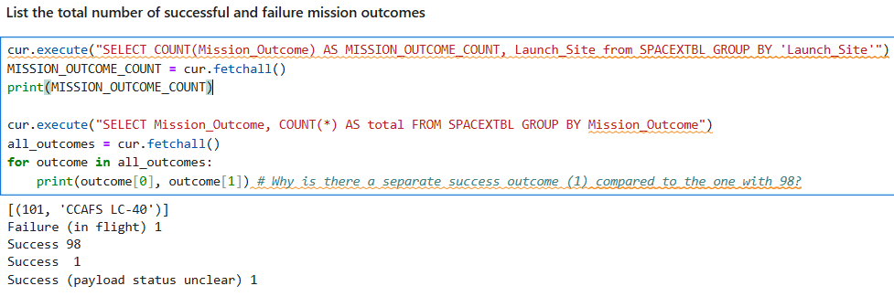
Total number of successful and failure mission outcomes
The first query counts how many missions were launched from each site, giving an idea of site activity.
The second query counts all missions by their outcome.
Out of all the launches, most were successful (98), with 1 failure and 1 status unclear.

Slide 30
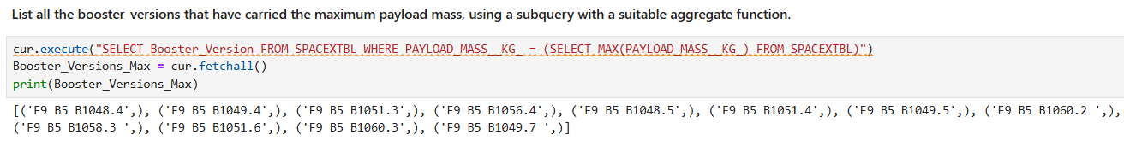
Boosters carried maximum load
This query listed all boosters carrying the maximum payload mass.
Results show that 12 rockets were launched carrying the maximum payload.

Slide 31
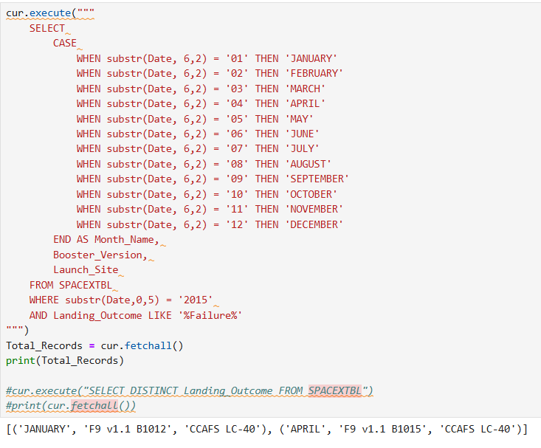
2015 launch records
This query lists all launches in 2015 where the boosters failed to land on the drone ship.
It shows the month of the launch, booster version, and the launch site. For example, in January 2015, booster F9 v1.1 B1012 from CCAFS LC-40 failed its landing.

Slide 32
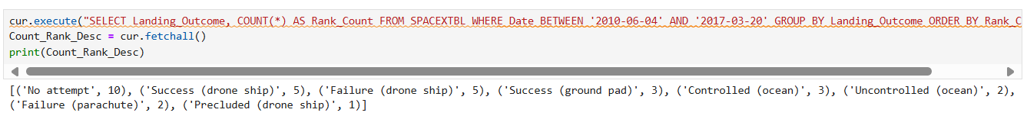
Rank landing outcomes between 2010-06-04 and 2017-03-20
Between June 2010 and March 2017, SpaceX recorded various landing outcomes, which can be ranked by frequency.
The most common outcome was ‘No attempt’ with ten occurrences.
Successful and failed drone ship landings both happened five times, while ground pad successes and controlled ocean landings were less frequent.
This ranking highlights the early challenges and progress in booster recovery efforts.

Slide 33
Launch sites proximities analysis

Slide 34
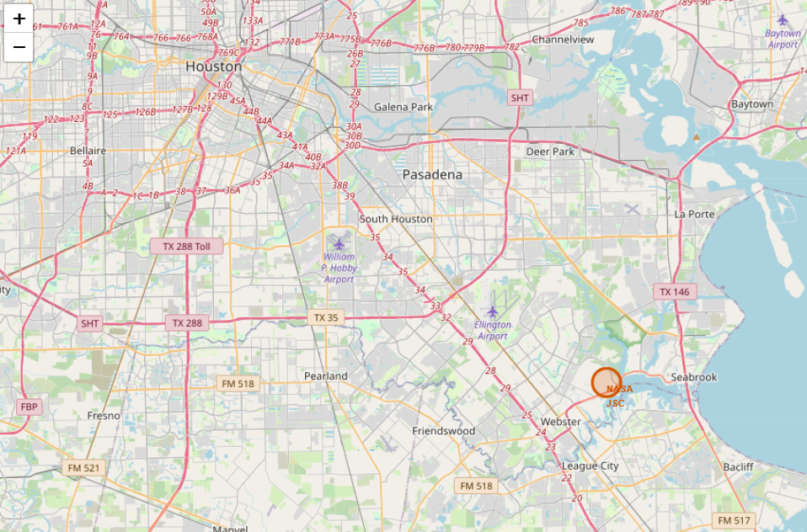
Marking the launch site

Slide 35
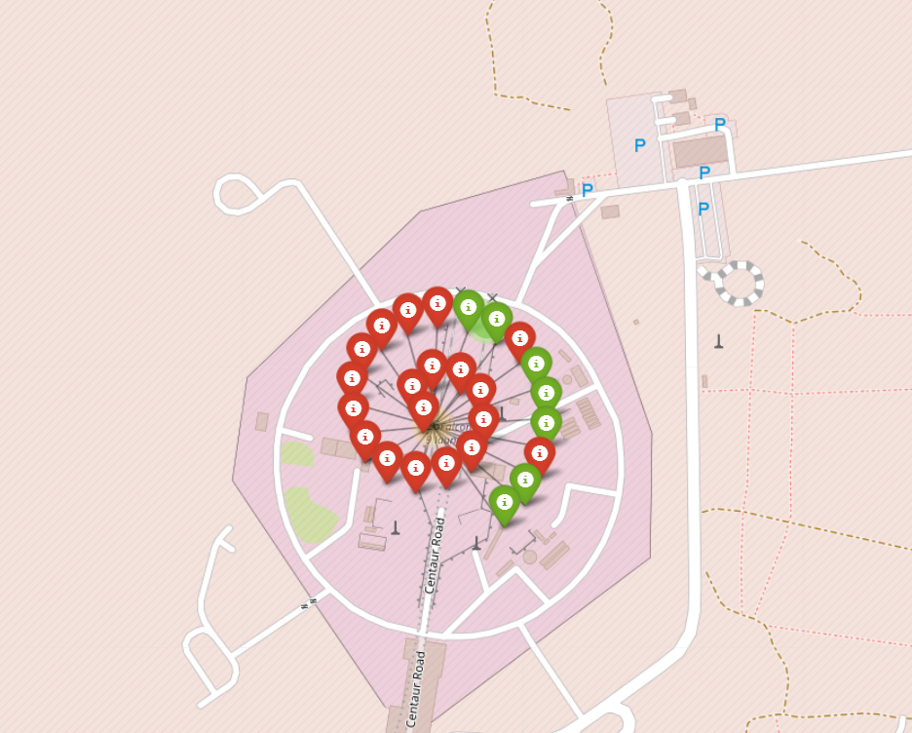
Marking the success/failed launches for each site

Slide 36
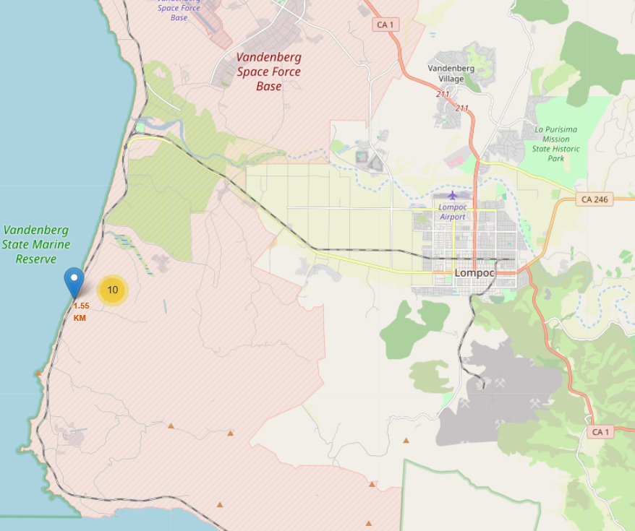
Calculating the distance from a launch site to its proximities

Slide 37

Building a dashboard with plotly

Slide 38
1

Slide 39
2

Slide 40
3

Slide 41

Predictive analysis (classification)

Slide 42
Classification accuracy

Slide 43
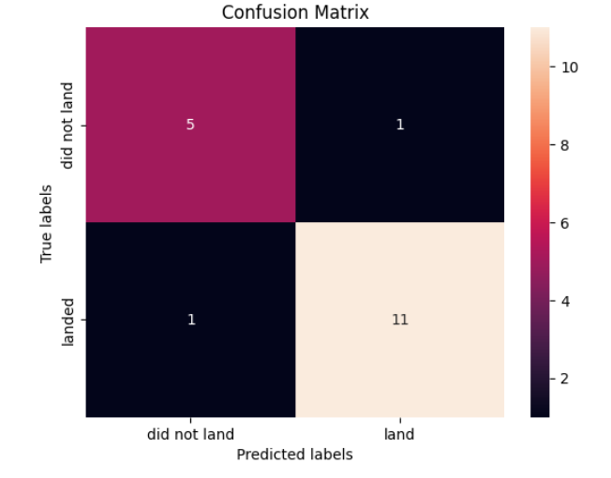
Confusion matrix

Slide 44
conclusion

Slide 45
Appendix

Slide 46
Thankyou data science

